Slide 1
From Web to Web Application
Vecna Medical
January 17, 2013
Ben Bau, Oleg Golberg, Savić Rašović

Slide 2
Introductions
Ben Bau, VP of Software Engineering
Oleg Golberg, Chief Architect, Patient Self-Service
Savic Rasovic, Lead UI Designer

Slide 3
We’re from Vecna.
Founded in 1998 by MIT alumni
Located at Alewife
Mission: to create technologies that improve healthcare

Slide 4
Today’s discussion
The unlikely evolution of web applications
Choosing the technology stack
Database to user: practical considerations
Usability & Design: why you should care

Slide 5
The unlikely evolution of web applications (Ben)

Slide 6
HTML, Javascript, CSS
HTML: a method for structuring and linking
CSS: defines the look and feel of a markup document
Javascript: a scripting programming language and historically one of the most abused programming languages

Slide 7
HTML, Javascript, CSS
How did this become the dominant programming methodology?

Slide 8
Code for All
HTML/Javascript/CSS is
code that anyone can write
accessible from any device
retrieved with little or no work by an end user

Slide 9
The power of the decorator
A design pattern that allows behavior to be added to an individual object, either statically or dynamically, without affecting the behavior of other objects from the same class.*
*wikipedia

Slide 10
jQuery is a library based on
The decorator design pattern
Progressive enhancement
jQuery-UI, theming, theme-roller
Plugins & widgets

Slide 11
All of these in action

Slide 12
What defines a web application?

Slide 13
What defines a web application?
A website with code running on a server backing it

Slide 14
What defines a web application?
A website with code running on a server backing it
A website that can mimic the responsiveness, functionality, and feel of a native application

Slide 15
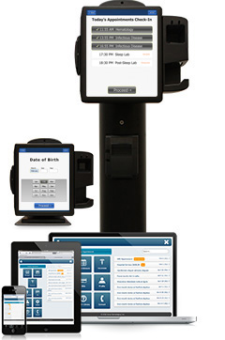
What do we want from a web app?
Usable by every person regardless of disability
Usable on a phone, tablet, computer, or touchscreen kiosk
Able to collect and deliver the right information to and from the user

Slide 16
Responsive design
Decorate differently based on size of the screen

Slide 17
What do want from a multi-select?
Show options that are relevant to the user
Collect the user’s selections
Potentially save the user’s selections
Return a response to the user

Slide 18
How do we get there?

Slide 19
Choosing the technology stack (Ben)

Slide 20
How do we get there?
Store information
Retrieve the information
Show the information to the end user
Collect the end user’s response
Potentially store the response
Return something to the end user

Slide 21
Store Information
File system
Relational database (SQL)
No-SQL database

Slide 22
Retrieve Information
Use SQL
Use Object Relational Mapping (ORM) library

Slide 23
Retrieve information
The Middle Tier, for example:
Java
Ruby on Rails
.net

Slide 24
Show it to the end user
Return a response directly
Server-side Model View Controller framework
HTML and javascript code can be generated server-side
OR
Use AJAX requests and responses

Slide 25
Beyond jQuery
http://backbonejs.org/
A javascript MVC framework
Maintains a model on the client-side, syncs it with the server, and updates the view (html) based on change events to the model
Uses a template engine like underscore.js to generate html

Slide 27
Database to user: practical considerations (Oleg)

Slide 28
A request comes in
/patientQueue/list.do?search.from=2013-01-01&search.to=2013-01-02
The URL is mapped to a piece of code
PatientQueueAction.list
The piece of code decides what to do

Slide 29
A request comes in
/patientQueue/list.do?search.from=2013-01-01&search.to=2013-01-02
The URL is mapped to a piece of code
PatientQueueAction.list
The piece of code decides what to do
This is the Controller
(the C in the MVC)

Slide 30
From Controller to Model
class PatientQueueAction { PatientService patientService; String list(PatientSearch search, <..>) { List<Patient> patients = patientService.find(search); <..>
return "success";
} }

Slide 31
The data
Domain model
Comes from a (relational) database
Needs to be translated into the domain model with an ORM tool (hibernate)

Slide 32
How do I query it?
Take the search criteria
Build the query
Done!

Slide 33
How do I query it?
Somewhere in the model:
class PatientServiceImpl implements PatientService { List<Patient> searchPatients(PatientSearch search) { return createQuery("from Patient where
arrivalTime between :from and :to")
.setParameter("from", search.from)
.setParameter("to", search.to) <..>
}
}

Slide 34
How fast is my query?
Millions of rows
Scanning through each row is slow
Index the data

Slide 35
Query returns too much data
All layers of the webapp cry
Does not scale

Slide 36
Paging!
Always page results
Save the server
Save the user
Nobody wants to see 1000 records at once
Bandwidth
Some browsers are slower than others

Slide 37
How to page?
Incorporate limit/offset into the query
Page 1, 2, …, 100
Additional count query
Do the users care?
Next page, more…, infinite scroll

Slide 38
Does this look right?
select * from patient join appointment on appointment.patient_id = patient.id join alert on alert patient_id = patient.id where arrival_time between <..> offset 0 limit 50;

Slide 39
The evil join
Joins break offset/limit
50 patient-appointment-alert combinations vs. 50 patients
Multiple joins blow up the result set
Workaround – multiple queries
select * from patient where arrival_time between <...> select * from appointment where patient_id in (?, ?, ...) select * from alert where patient_id in (?, ?, ...)

Slide 40
The view
Data + template = HTML
<div>${patient.name}</div>
<div>John Doe</div>
Controller hands off the data to the template

Slide 41
Templates
Server-side (JSP, Freemarker, …)
Server response is plain HTML
Easy to decorate the data
Client-side (mustache, underscore, …)
Server response is JSON
Another representation of the data
Compact (if you do it right)
Another level of abstraction

Slide 42
Page refresh
Full page refresh
If users don’t do it often
AJAX refresh
HTML fragment, server-side template
JSON, client-side template

Slide 43
Usability & Design: Why you should care (Savic)

Slide 44
Design Principles
Value - product value to a user?
Adoptability - easy to start using? spread the word?
Usability - easy to complete a goal?
Desirability - a good experience? fun? engaging?

Slide 45
BREC beautiful responsive ergonomic configurable

Slide 46
BREC
beautiful responsive ergonomic configurable
Standard of comparison
Cultural perception
Typography and vertical rhythms
Colors and language

Slide 48
BREC beautiful responsive ergonomic configurable
Responsive agnostic design using media queries
User action always produces system reaction
Loading time
Disabled action buttons
Hovers are dead

Slide 49
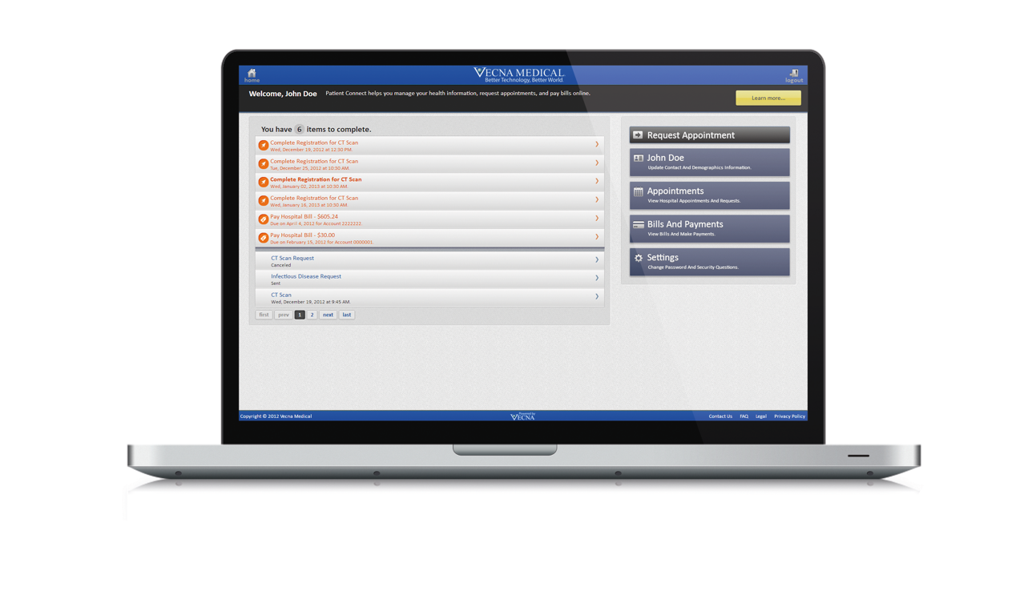
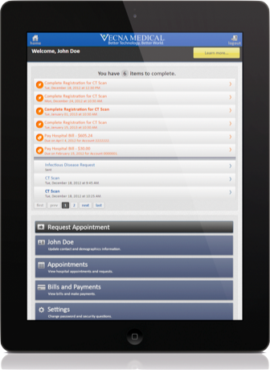

Slide 50
BREC beautiful responsive ergonomic configurable
Design for all
508 Accessibility (software, hardware, facilities)
WCAG
UX: storyboards, user personas, industry questionnaires and test methods
Ask thyself: what is your user’s goal?

Slide 51
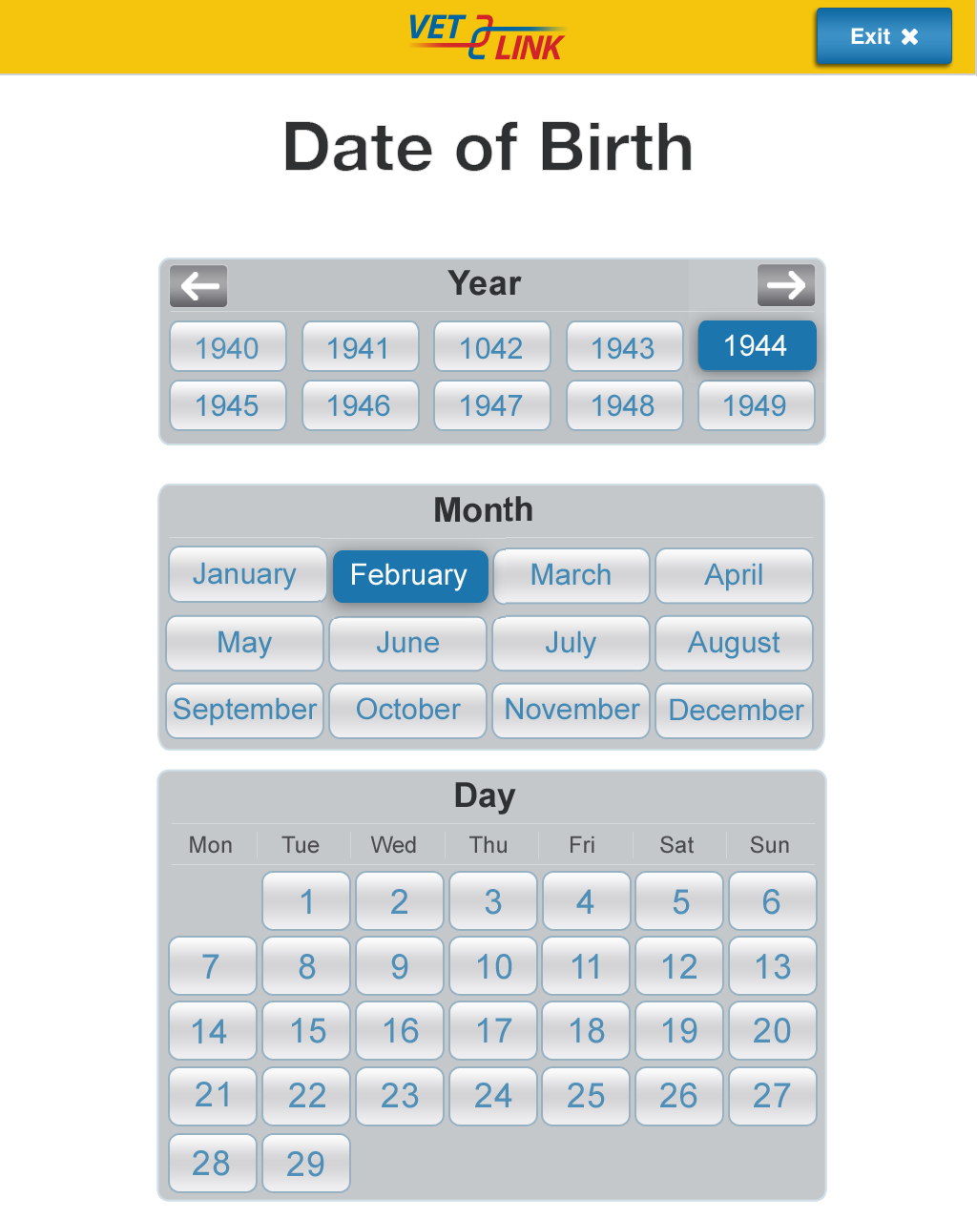

Slide 52
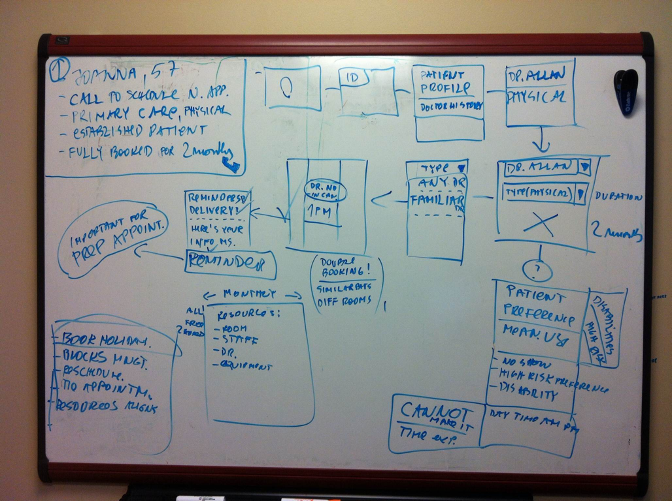

Slide 53
BREC beautiful responsive ergonomic configurable
Patient vs. provider localization
Role and action based

Slide 54
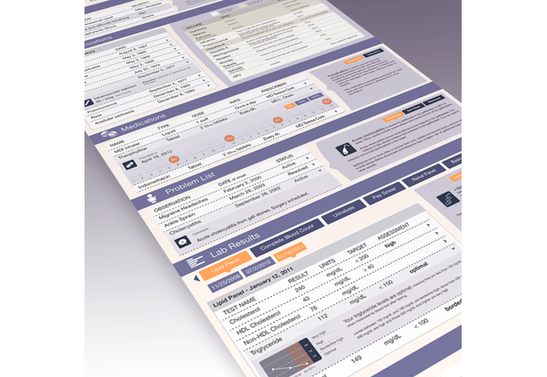
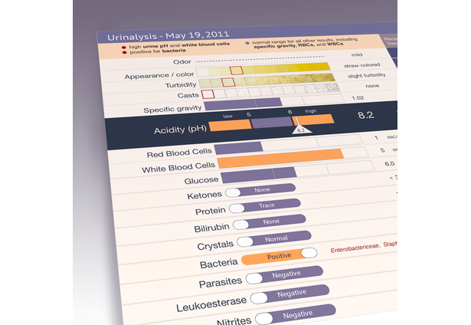

Slide 55
DESIGN FRAMEWORK
Responsive mobile first HTML5/CSS3
Media Queries in CSS
Modernizr and Normalize scripts
jQuery and jQuery UI library
Mobile first by Luke W.
HTML5boilerplate.com
SmashingMagazine.com

Slide 56
/* iPads (portrait and landscape) ----------- */@media only screen and (min-device-width : 768px) and (max-device-width : 1024px)
{/* Styles */}/*
iPads (landscape) ----------- */@media only screen and (min-device-width : 768px) and (max-device-width : 1024px) and (orientation : landscape)
{/* Styles */}/*
iPads (portrait) ----------- */@media only screen and (min-device-width : 768px) and (max-device-width : 1024px) and (orientation : portrait)
{/* Styles */}

Slide 57
DESIGN POLITICS
Fix healthcare
Improve lives of patients and providers
Raise the bar
the world needs constant improving

Slide 58
thank you

Slide 59
On-campus Interviews
Vecna will be at MIT
Feb 19th & Feb 20^{th,} Mar 7th, Mar 19th, Apr 10th

Slide 60
Apply on MIT CareerBridge
Fulltime and internship positions for software engineering

Slide 61
Our software engineers
Build intuitive user interfaces to provide patients of all age groups with convenient access to their entire medical record using technologies such as HTML5, CSS3, and jQuery.
Help build a flexible and scalable backend to accommodate a growing network of healthcare systems.
Use an industry standard technology stack comprised of Java, Spring, Hibernate, Struts, and CXF.
See their code quickly impact millions of patients with Vecna’s rapid release cycles.
Collaborate with UI/UIX designers, project managers, and quality assurance test engineers in a cross functional project team structure.
Integrate Vecna products with a wide range of third-party healthcare solutions using web services, HL7, and other technologies.
tl; dr: Code something that matters. Join Vecna.

